Slide 1
Docker basics
Andrea Panizza

Slide 2
Contents
docker why
docker what
docker how
depend --on-docker
docker --deep-learning
docker resources

Slide 3
docker why
Choose an OS
Install CUDA and CuDNN
Install python (2.7? 3.5? 3.8?) & libraries
Install tensorflow
TF & CUDA versions not compatible
Expose ports
Possible conflicts
Breaking updates
Different OS/libraries in Dev/Prod
Ok, but now it doesn’t scale
HEEEEELLLLPP!!!!!!
Install Docker
Write a Dockerfile
docker build
docker run

Slide 4
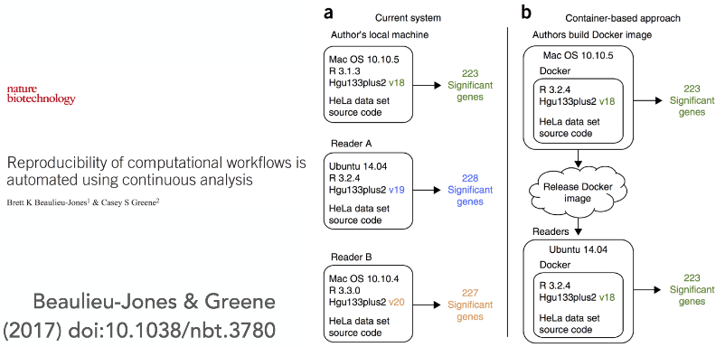
docker why
A true story

Slide 5
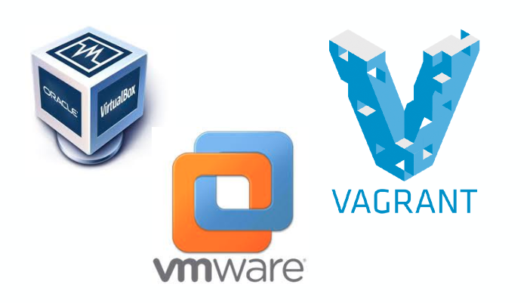
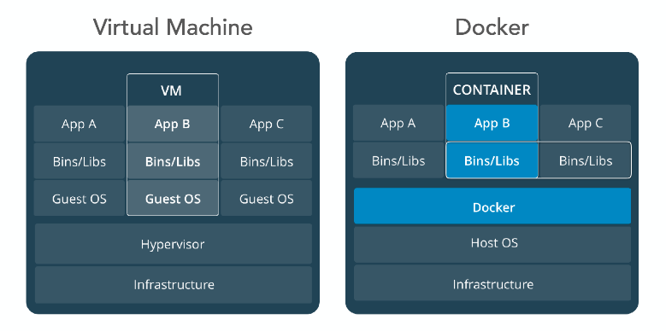
docker what
virtual machines solve the dependency issue…
…but they’re very resource-intensive (scalability). We need a lighter framework

Slide 6
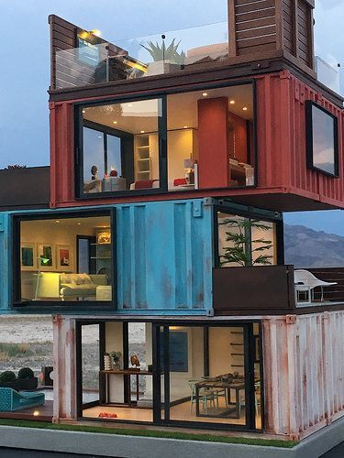
docker what
Docker containers are:
Cheaper
Less computational overhead
Trendy
Made to crash and be restarted
Scaling and coordinating is easy
Develop code in your preferred environment, run anywhere

Slide 7
docker what
Docker containers are not virtual machines:
“VMs are like houses, each is a single unit w/ standalone plumbing and wiring. Containers are like apartments; each one is a unit (process) in a host (building), sharing the plumbing and wiring w/ one another as well as the rest of the building” (Mike Coleman - Technology Evangelist, Docker)

Slide 8
docker vocabulary
image |  | package defining a working environment (binary file)
container |  | a running instance of an image (process)
Dockerfile |  | text file containing commands to build an image
Docker Hub |  | A website/repository for sharing Docker images
Docker client |  | sends CLI commands to Docker daemon through Docker REST API (process)
Docker daemon |  | executes calls from Docker client
Docker native client/server architecture makes it easy to design web services

Slide 9
docker architecture

Slide 10
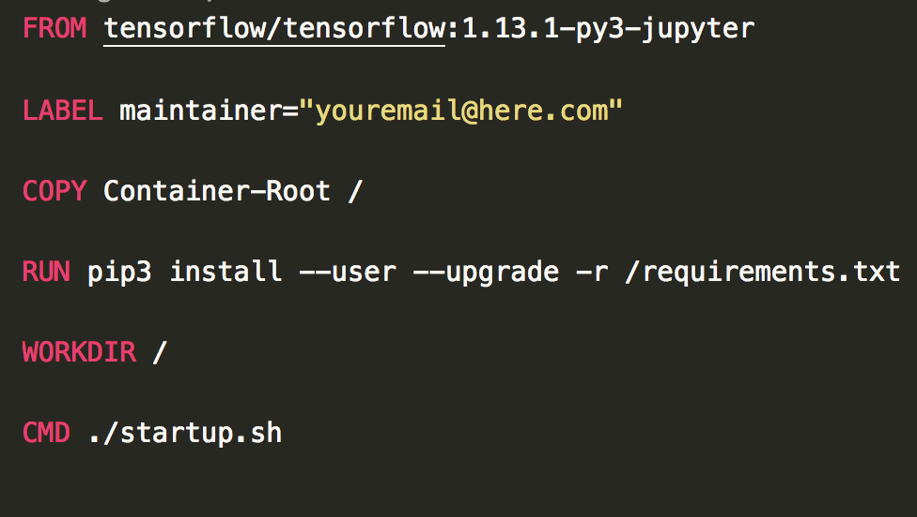
docker how
Define an image by writing a Dockerfile
FROM: initialize a new build stage & set base image. A valid Dockerfile must start with FROM.
LABEL: add metadata to an image (key/value pair). A typical key is maintainer
COPY: copy files/folders from <src> and add to container filesystem at path <dest>
RUN: execute commands in a new layer on top of the current image and commit results
WORKDIR: set working directory for any command which follows
CMD: defaults for the container execution

Slide 11
docker how
To build the image, from the Dockerfile directory run
docker build [BUILD_OPTS] -t IMAGE:[TAG] (tip: always name & tag your images)
Docker downloads the base image from the Web (if it didn’t do it before) and starts building. After building, to run the container, in any directory run
docker run [OPTIONS] IMAGE[:TAG|@DIGEST] [COMMAND] [ARG...]
(can be complicated…but see later!)
Each container is an instance of an image: you can run multiple (containers) instances based on the same image, as long as each has a unique name.
Containers are stateless and immutable: once a container completes execution, all its content is lost, and any other container started from the same image doesn’t inherit any state from the first one (reproducibility).

Slide 12
Mapping local folders
All content from a Docker container is lost, once it terminates execution. In order to export content from it, we map a folder on the host filesystem, to a folder in the Docker container filesystem. Example:
docker run -v /home/andrea/docker_test:/test -it ubuntu /bin/bash
maps the folder docker_test on the host system to the folder /test in the Docker container, starts a container based on the ubuntu image in interactive mode and drops you in the bash shell.

Slide 13
depend --on-docker
Depend On Docker is a framework developed at BHGE Digital which helps building, shipping & running applications with Docker.

Slide 14
docker --deep-learning
Let’s build a simple image and make some practice with Depend on Docker
We will create an image to run a pre-trained ResNet-50 model in Keras, inside a Jupyter notebook
git clone https://github.com/AndreaPi/docker-training-2019-public.git

Slide 15
Manage images/containers
docker images -aq |  | List all images
docker ps -a |  | List all containers: you need to remove containers before you can remove images
docker rm <container-ID> |  | remove container
docker rm $(docker ps -aq) |  | remove all containers
docker rmi <image-ID> |  | remove image
docker rmi $(docker images -aq) |  | Remove all images
docker run --rm --it --name cntr myimage |  | run container with name cntr, from image myimage, in interactive (it) mode and remove (rm) container after you exit: great to avoid having many hanging containers

Slide 16
docker resources
the official Docker cheatsheet
Another cheatsheet
Yet another one
Some Docker notes
https://docs.docker.com/engine/reference/builder/
https://docs.docker.com/develop/develop-images/dockerfile_best-practices

